Slide 1

Computer Vision Project
Emotion Classification using MobileViT
Presented By:
Muhammad Bilal (FA21-BAI-014)
Abdul Haseeb (FA22-BAI-002)
Abdullah Ejaz (FA22-BAI-004)

Slide 2
Introduction of MobileViT
The MobileViT model is a lightweight hybrid neural network architecture that combines the strengths of Convolutional Neural Networks (CNNs) and Vision Transformers (ViTs) to achieve efficient and accurate performance on vision tasks, especially on resource-constrained devices like mobile phones and embedded systems.

Slide 3
Overview of MobileViT
Name: MobileViT = Mobile + Vision Transformer
Purpose: Designed for mobile and edge devices with low computational power.
Introduced by: Apple in the paper “MobileViT: Light-weight, General-purpose, and Mobile-friendly Vision Transformer” (2021).
Key Idea: Embed transformer blocks into a CNN-based architecture to gain global context modeling while maintaining the efficiency of CNNs.

Slide 4
Architecture Highlights
CNN + Transformer Hybrid:
Local features extracted via CNN.
Global context captured by Transformer layers inserted into the network.
MobileViT Block:
A key innovation in the architecture.
Structure:
Local feature extraction with convolutions.
Flatten and rearrange the features into patches.
Pass through a transformer encoder to capture long-range dependencies.
Rearrange back and merge with the CNN pipeline.
Efficiency-Oriented Design:
Uses depthwise separable convolutions like MobileNet.
Transformer blocks are small and optimized for mobile use.

Slide 5
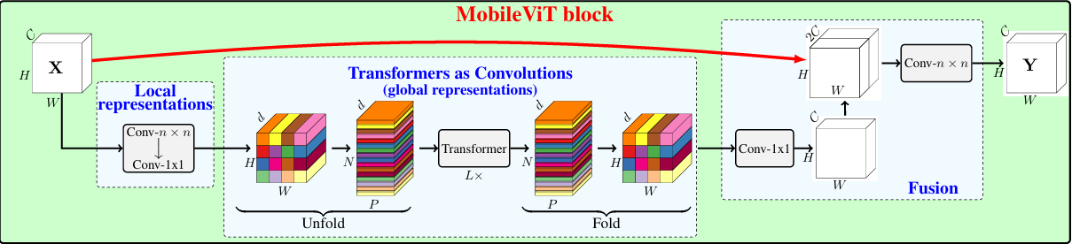
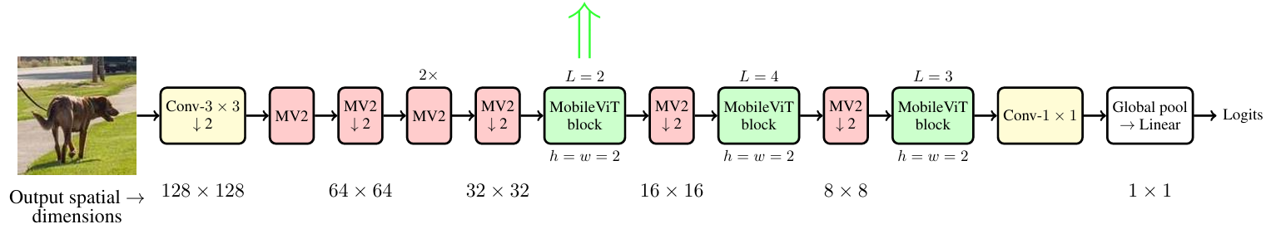
Architecture Highlights

Slide 6
Performance
Comparable or better accuracy than MobileNetV2, MobileNetV3, and EfficientNet-lite on benchmarks like ImageNet.
Achieves good trade-offs between:
Accuracy
Model size
Latency on mobile CPUs/NPUs

Slide 7
Use Cases
Real-time image classification
Object detection (e.g., in YOLOv6 and YOLOv7 backbones)
Edge and mobile AI applications

Slide 8
Project Overview
Objective: Classify images into 5 categories: F, H, Sad, S, N
Model: Pretrained MobileViT-Small (from TIMM library)
Dataset: Custom dataset in .pt format with preprocessed tensors
Framework: PyTorch with DataLoaders, Augmentations, Custom Training Loop

Slide 9
Different Fine-Tuning Strategies for MobileViT
Hybrid Fine-Tuning Strategy: Use Differential Learning rates for different Layers
CNN-Style with Transformer Awareness: Add different optimizers and schedulers, Augmented regularization via Dropout, LR scheduling, label smoothing
ViT-Style with Parameter Efficiency: Adding small trainable modules between transformer layers allows efficient adaptation/ Modify the head
Linear Probing: Train only the new head.
Gradual Unfreezing: Gradually unfreeze layers

Slide 10
Dataset Preparation
Custom TensorImageDataset class wraps tensor data + filenames
Data split: train, validation, test
Data Augmentation:
Resize → RandomCrop → Flip → Jitter → Affine → Blur
Normalization using ImageNet stats
Transformations applied differently for train vs. validation/test

Slide 11
Model Setup and Architecture
Imported using timm.create_model('mobilevit_s', pretrained=True)
Head reset for 5 classes using model.reset_classifier()
Modified Head: Added dropout, 2 FC layers, ReLU, BatchNorm
Training strategy:
Train only classification head until 40 epochs
Gradually unfreeze the layers after that

Slide 12
Training Strategy
Loss Function: CrossEntropyLoss with label smoothing (0.1)
Optimizer: AdamW
Head LR: 1e-4, Backbone LR: 1e-6
Weight Decay: 1e-4, 1e-5
Scheduler: ReduceLROnPlateau
Reduces LR when val loss plateaus
patience = 3, factor = 0.5
Replaced Cosine LR due to fluctuating validation metrics in earlier experiments

Slide 13
Training and Evaluation
Epoch loop: Train → Evaluate → Save Best Models
Training includes:
Loss backpropagation
Accuracy tracking
Best models saved:
Based on minimum validation loss

Slide 14
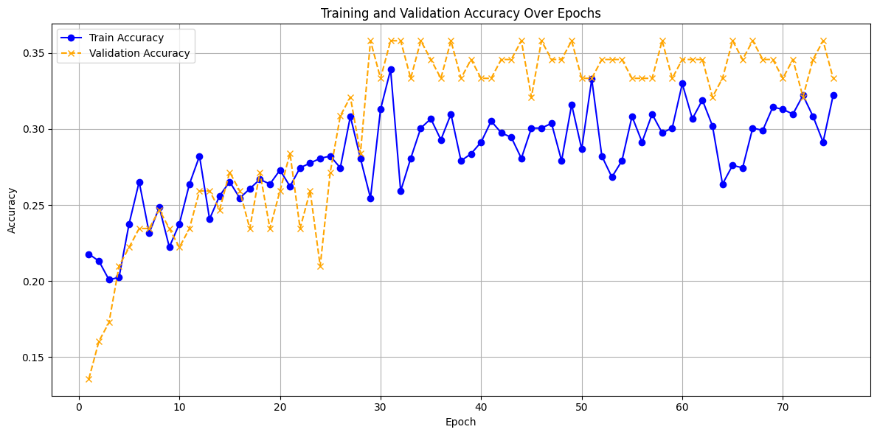

Slide 15
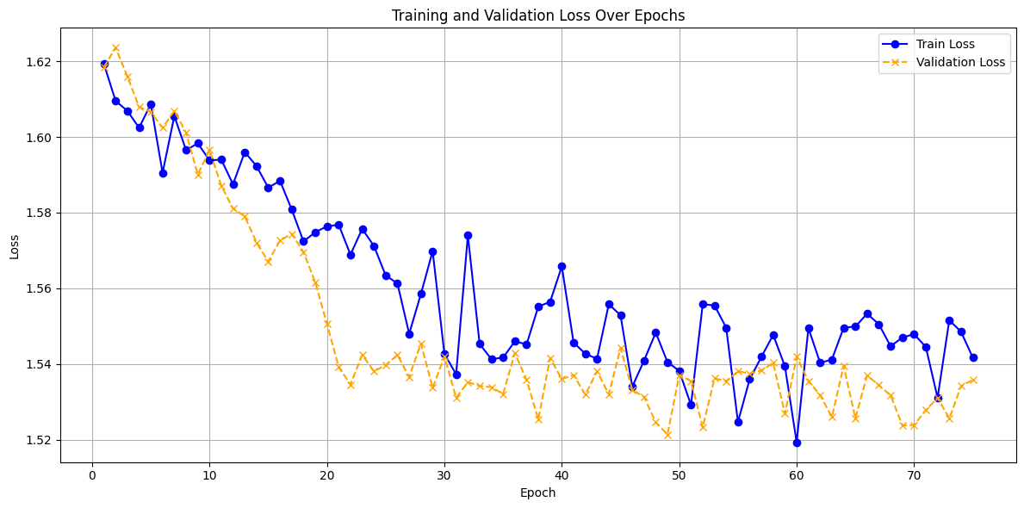

Slide 16
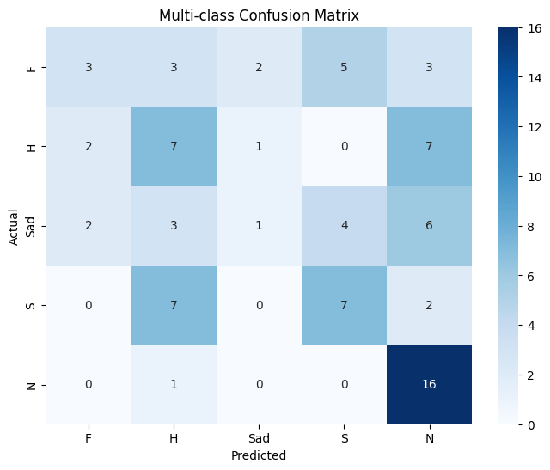

Slide 17
Detailed Classification Report
Class | Precision | Recall | F1-Score | Support
F | 0.43 | 0.19 | 0.26 | 16
H | 0.33 | 0.41 | 0.37 | 17
Sad | 0.25 | 0.06 | 0.10 | 16
S | 0.44 | 0.44 | 0.44 | 16
N | 0.47 | 0.94 | 0.63 | 17
Overall Accuracy |  |  | 0.41 | 82
Macro Avg | 0.38 | 0.41 | 0.36 | 82
Weighted Avg | 0.38 | 0.41 | 0.36 | 82

Slide 18
Class-wise Accuracy
Class | Accuracy
F | 18.75%
H | 41.18%
Sad | 6.25%
S | 43.75%
N | 94.12%

Slide 19
Combined Metrics Report
Class | Precision | Recall | F1-Score | Support | Accuracy
F | 0.428571 | 0.187500 | 0.260870 | 16.000000 | 0.187500
H | 0.333333 | 0.411765 | 0.368421 | 17.000000 | 0.411765
Sad | 0.250000 | 0.062500 | 0.100000 | 16.000000 | 0.062500
S | 0.437500 | 0.437500 | 0.437500 | 16.000000 | 0.437500
N | 0.470588 | 0.941176 | 0.627451 | 17.000000 | 0.941176
Accuracy | 0.414634 | 0.414634 | 0.414634 | 0.414634 | None
Macro Avg | 0.383999 | 0.408088 | 0.358848 | 82.000000 | None
Weighted Avg | 0.384437 | 0.414634 | 0.362241 | 82.000000 | None

